Slide 1
UNIT 15 – Object oriented programming
With ben read

Slide 2
Aims & objectives
Analyse the concepts of Objects and Classes in C++
Discuss class declaration and definition, encapsulation and use of methods
Review the week’s techniques via a self-paced tutorial

Slide 3
classes
So far you have implemented functions in order to process data, along with variables and structures to support them. This is the foundation of Procedural Programming.
In Object Oriented Programming, you identify the data required to perform a task, how it relates to other data, and what functions and structures are required to support those relationships. You then combine all of these things into a CLASS.

Slide 4
classes
A Class is a custom datatype, but far more advanced than types created with typedef. They are complex datatype templates, and new variables created from the datatype inherit the properties of the parent class. These new variables are called OBJECTS. By using objects in our programming we are able to take advantage of some new features, as well as enhance our use of modularity. These features are –
Encapsulation – Combining data and functionality in one place
Abstraction – Hiding implementation details
Inheritance – Extension of datatypes
Polymorphism – Functions in subclasses will run code relevant to the properties of the calling object

Slide 5
classes
Classes are made up of attributes and methods. Attributes are variables which belong to the class. Methods are the class’s functions. A class is usually designed to represent the properties, state and behaviour of a specific type of entity. In the example to the right, we have a class called Car. It has three attributes (variables) and two methods (functions).
Class: Car
Attributes | Model
 | Engine Size
 | Speed
Methods | Accelerate()
 | Brake()

Slide 6
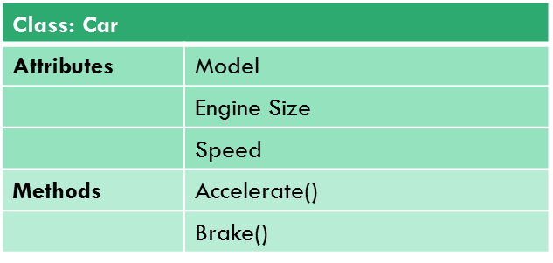
objects
Objects are copies of a class in the same way that a variable is a copy of a datatype. An object is, in essence, a variable with a lot more properties. Here we can see some objects that have been created from the Car class’s ‘blueprint’ –
Each object contains all of the attributes and methods defined by the class it was created from
Object: marks_Car
Model | BMW 323
Engine Size | 2.5
Speed | 70
Accelerate()
Brake()
Object: marks_Next_Car
Model | Bugatti Veyron
Engine Size | 8
Speed | 250
Accelerate()
Brake()

Slide 7
Declaring a class
Declaring a class is very similar to declaring a structure. However, classes can contain methods as well as attributes and these are declared as being either public or private -
class Car
{
private:
int m_speed; // private attribute
void turnOnBrakeLight(void); // private method
public:
char m_model[50]; // public attribute (unusual)
float m_engine_size; // public attribute (unusual)
void accelerate(void); // public method
void brake(void); // public method
};

Slide 8
encapsulation
The act of combining both the data and the functions which act on that data into one class is called ENCAPSULATION. Encapsulation allows programmers to treat the state and behaviour of an object as a single entity, whilst also restricting access to the object. In general, the attributes of a class are only accessible to the methods of that class. They are not visible outside of the class. The methods, on the other hand, are visible and can be called upon to act on their attributes
When objects are created, each object will contain a copy of all class attributes and methods, but only that object’s methods can affect its attributes. By restricting access in this way you can control who can access what and ensure your program is robust and secure. This hiding of data is called DATA ABSTRACTION

Slide 9
encapsulation
In order to provide abstraction, you need to make use of the PUBLIC and PRIVATE access specifiers within the class declaration. Attributes and methods declared with a public specifier are visible outside of the class. Those declared with a private specifier are only accessible from within the class.
Typically, your attributes will be private and your methods will be public.

Slide 10
Creating and accessing objects
The declaration of a class creates a new datatype. Variables declared using this datatype are called objects. They are declared in the same way as normal variables, e.g.
int x; //variable of type Integer
Car marks_Car; //object of type Car
Each object will inherit and then duplicate the attributes and methods of its parent class. These are totally separate from other objects. You can access the public attributes and methods of the object by using the dot operator, in the same manner as structures, e.g.
marks_Car.m_engine_size = 2.5f; //Sets engine size to 2.5
marks_Car.accelerate(); //Calls the accelerate function

Slide 11
Using classes in C++
It is good practice to create classes in their own separate file. This encourages correct modularisation and you can then advertise your classes to other programs using a header file.
The header file will contain the class declaration. The main file, with extension .cpp, will contain your function definitions and any private attributes and their values.

Slide 12
GETTERS & SETTERS
Because many of the attributes in our classes will be private, we need to write special methods to read and write to the data.
These partnered methods occur once for every private attribute in a class, meaning you will be seeing them a great deal.
They always take the same form, and thus we can use a shortened form of code layout to represent them, e.g.
void setPlayerSpeed(int speed) { playerSpeed = speed; };

Slide 13
GETTERS
Getters ‘get’ the values of the privates attributes. Therefore they always return a value and have the same datatype as the attribute they are interacting with. They also do not require any parameters, e.g.
int getPlayerHealth(void) { return playerHealth; };

Slide 14
SETTERS
Setters ‘set’ the values of the privates attributes. Therefore they never have a datatype, because they never return a value, but always have a single parameter of the same datatype as the attribute they are interacting with, e.g.
void setPlayerHealth(int health) { playerHealth = health; };

